Slide 1
Ensemble Learning
Bagging, Boosting, Gradient Boosting, XGBoost

Slide 2
Ensemble Method
Why train only one predictor when we can train many?
Training many predictor is computationally expensive
But what if we combine many predictors?
Ensemble of many predictors
Combination of many predictors
Weighted, Unweighted, Majority Voting, etc.
Same or different predictors

Slide 3
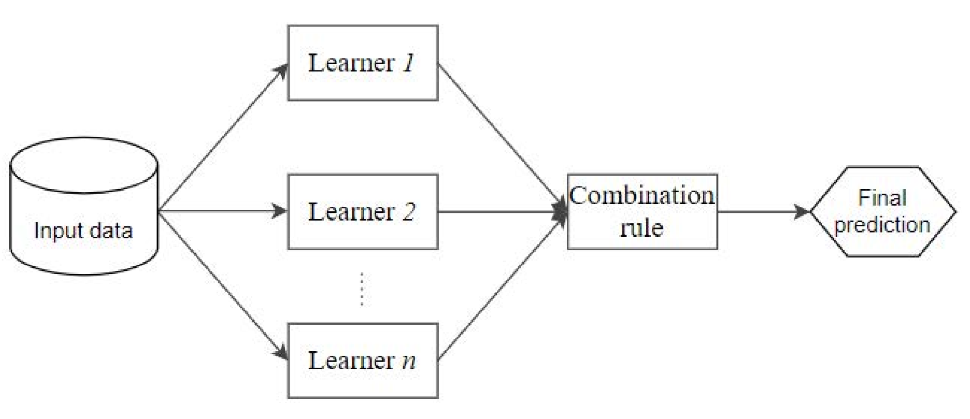
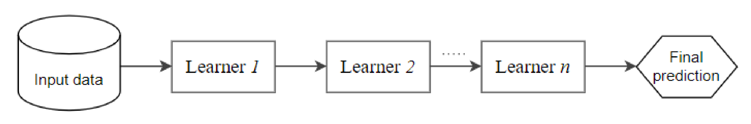
Ensemble Method
Parallel Ensemble Methods
Bagging
Sequential Ensemble Methods
Boosting

Slide 4
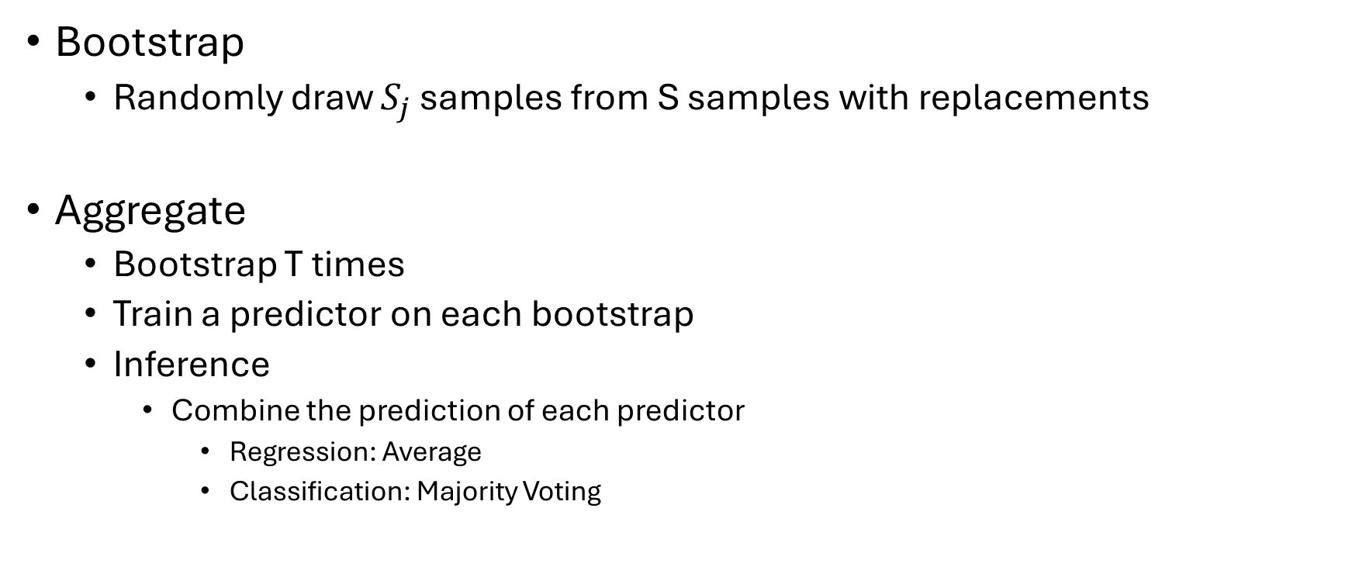
Bagging (Bootstrap Aggregating)
Bootstrap
Randomly draw $S_{j}$ samples from S samples with replacements
Aggregate
Bootstrap T times
Train a predictor on each bootstrap
Inference
Combine the prediction of each predictor
Regression: Average
Classification: Majority Voting

Slide 5
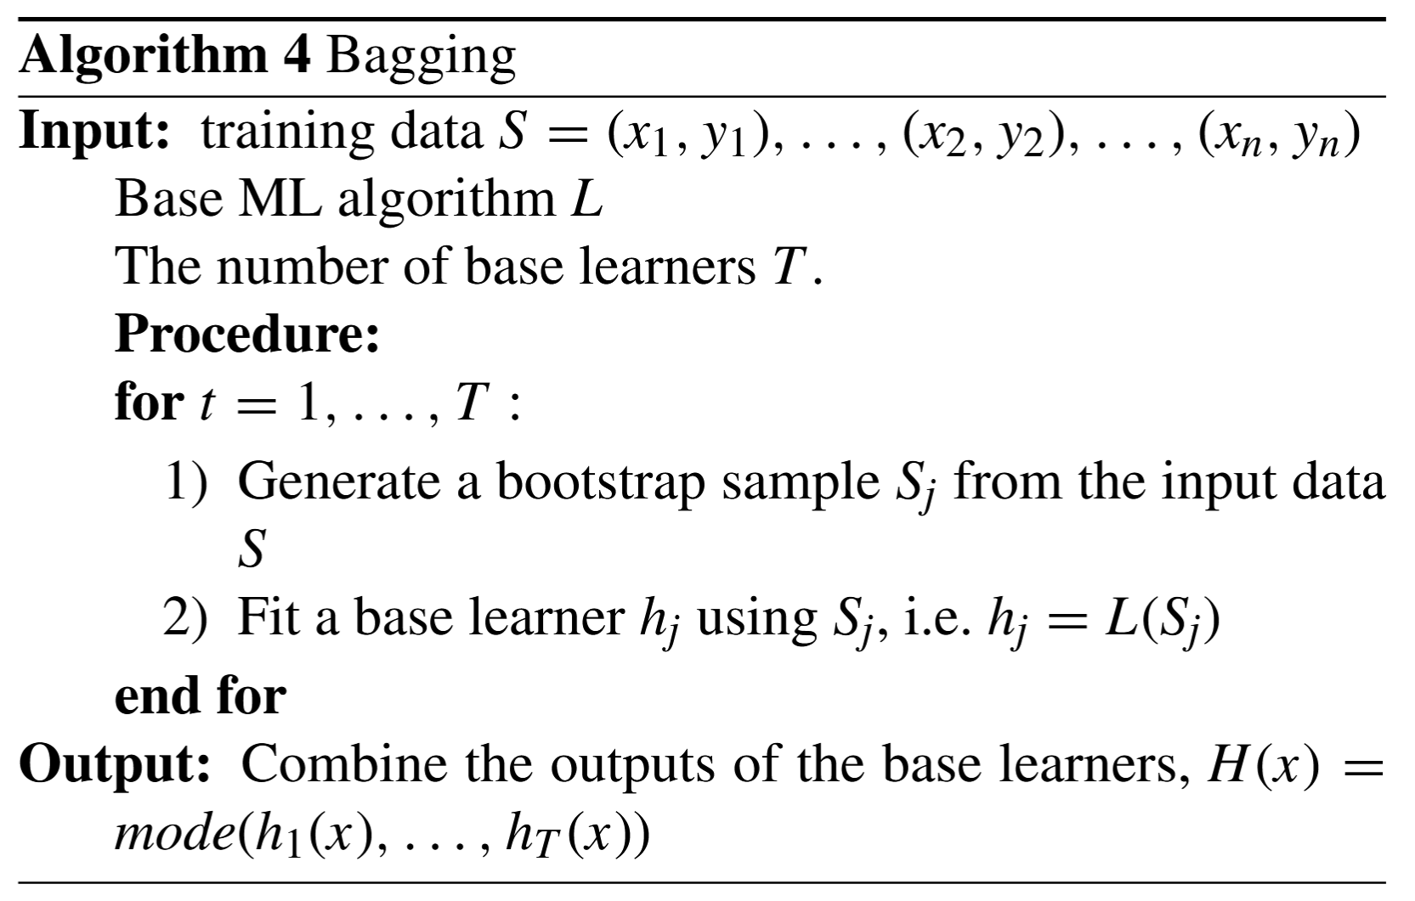
Bagging (Bootstrap Aggregating)

Slide 6
Bagging (Bootstrap Aggregating)
Why sample with replacement?
Several intuitions
Duplicate entries get more importance in the model
Each predictor focuses on different regions
Increased diversity among the predictors
Etc.

Slide 7
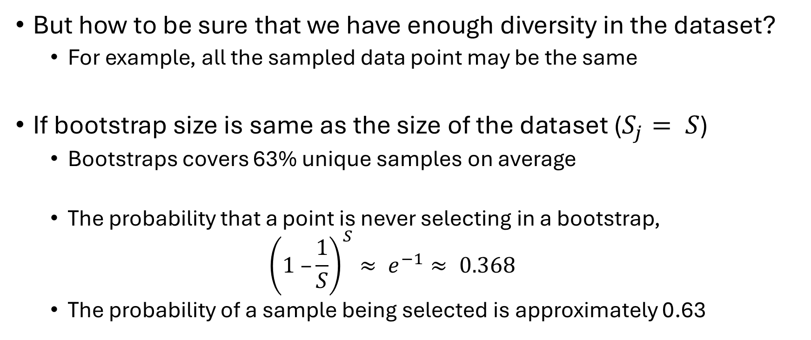
Bagging (Bootstrap Aggregating)
But how to be sure that we have enough diversity in the dataset?
For example, all the sampled data point may be the same
If bootstrap size is same as the size of the dataset ($S_{j}= S$)
Bootstraps covers 63% unique samples on average
The probability that a point is never selecting in a bootstrap,
$${\left(1 –\frac{1}{S}\right)}^{S}≈ e^{−1}≈ 0.368$$
The probability of a sample being selected is approximately 0.63

Slide 8
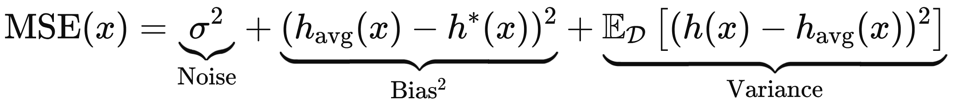
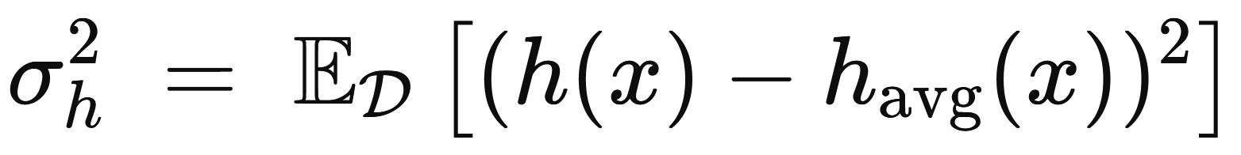
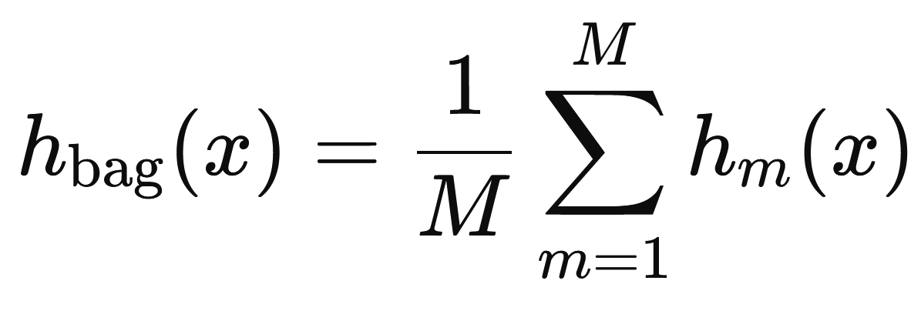

Bagging (Bootstrap Aggregating)
Why does bagging improve performance?
Recall bias-variance tradeoff for linear regression
Instead of $h(x)$we now have,

Slide 9
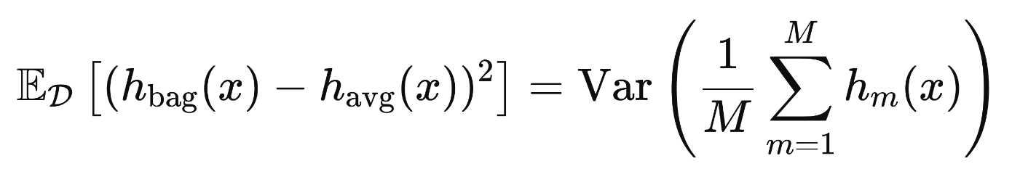
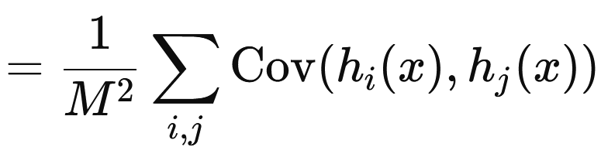
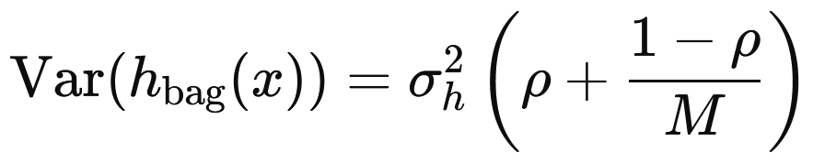


Bagging (Bootstrap Aggregating)
Let’s first focus only on the last term,
If the predictors are weakly correlated, say $Cov\left(h_{i}\left(x\right), h_{j}\left(x\right)\right)=ρ$
$$\left\{\begin{aligned}ρ=0 →\frac{σ_{h}^{2}}{M} \\ ρ=1 →σ_{h}^{2}\end{aligned}\right.$$

Slide 10
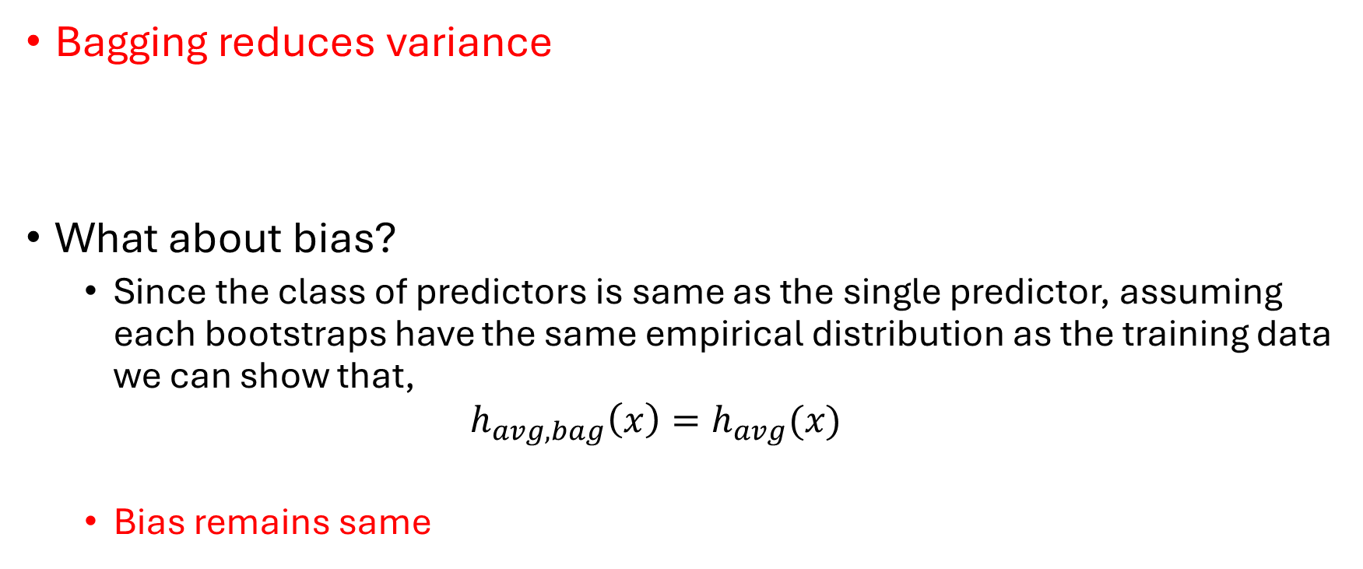
Bagging (Bootstrap Aggregating)
Bagging reduces variance
What about bias?
Since the class of predictors is same as the single predictor, assuming each bootstraps have the same empirical distribution as the training data we can show that,
$$h_{avg, bag}\left(x\right)=h_{avg}(x)$$
Bias remains same

Slide 11
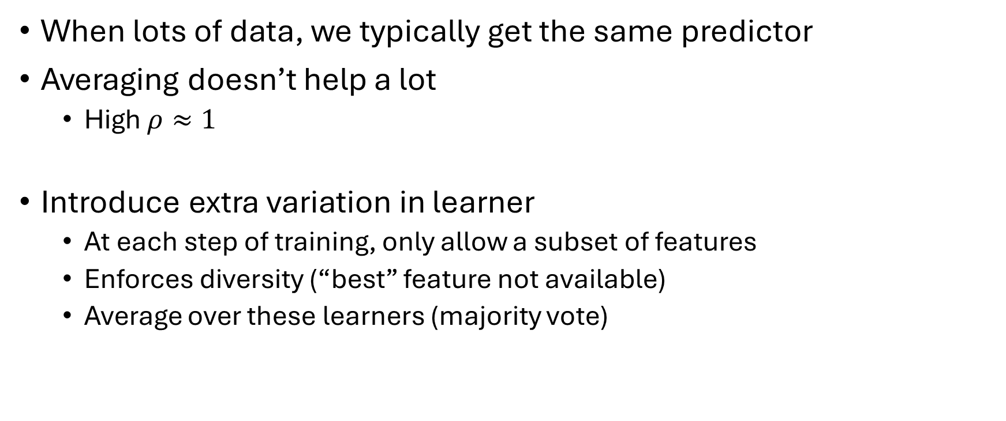
Random Forest
When lots of data, we typically get the same predictor
Averaging doesn’t help a lot
High $ρ≈1$
Introduce extra variation in learner
At each step of training, only allow a subset of features
Enforces diversity (“best” feature not available)
Average over these learners (majority vote)

Slide 12
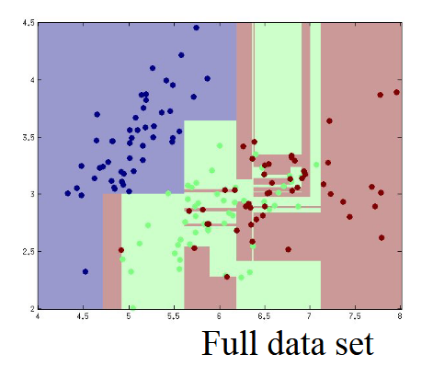
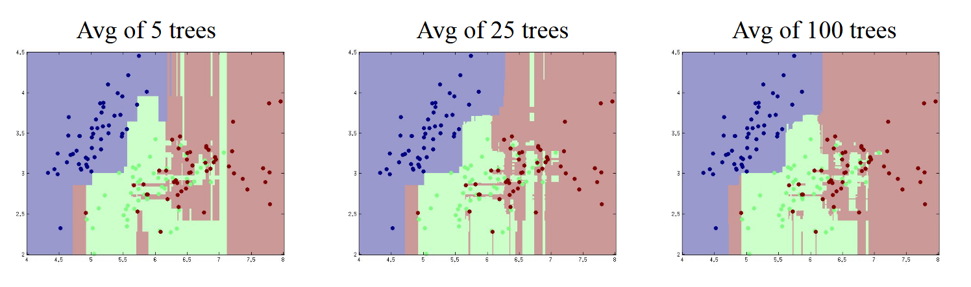
Bagging (Bootstrap Aggregating)
Visualization

Slide 13
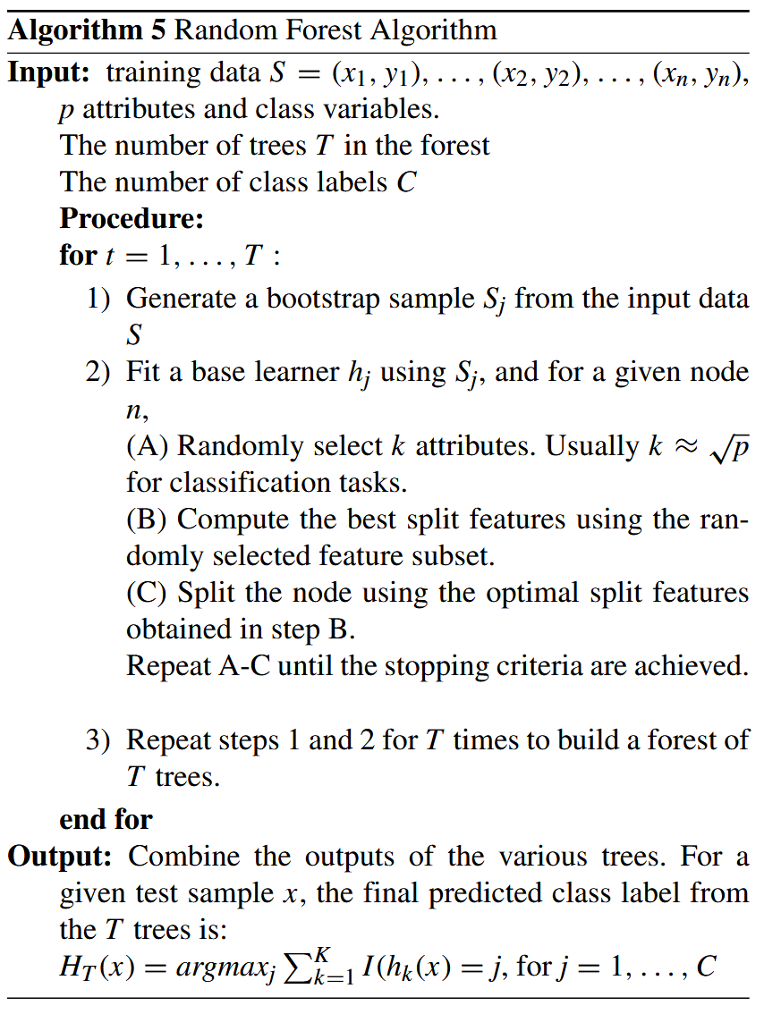
Random Forest

Slide 14
Random Forest

Slide 15
Boosting
Focus new experts on examples that others get wrong
Train experts sequentially
Errors of early experts indicate the “hard” examples
Focus later classifiers on getting these examples right
Combine the whole set in the end
Convert many “weak” learners into a complex classifier

Slide 16
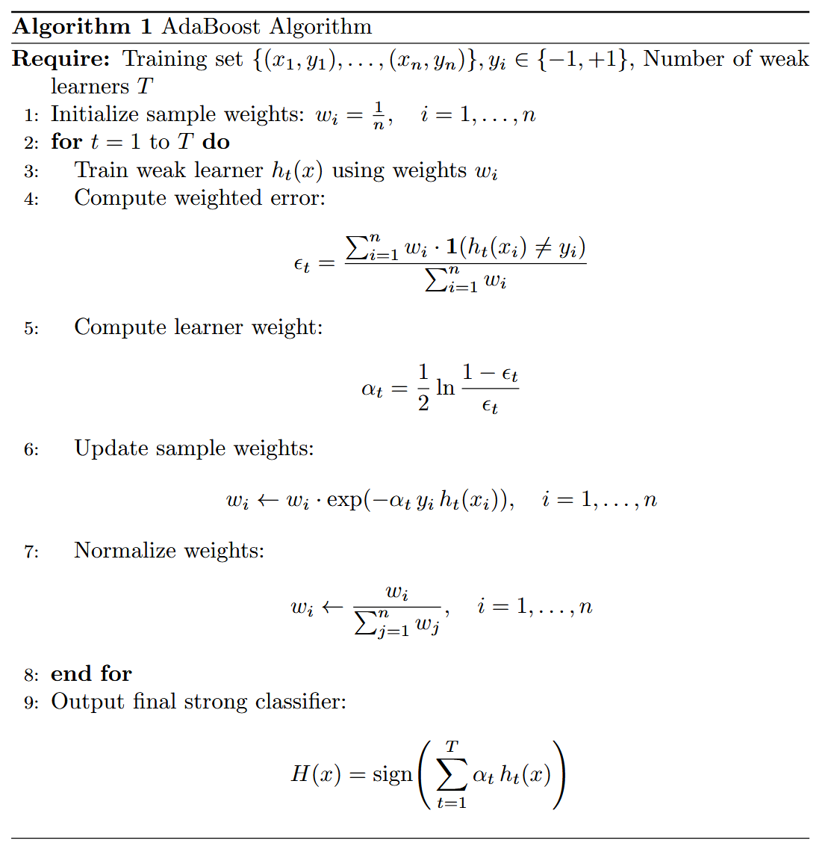
Adaboost

Slide 17
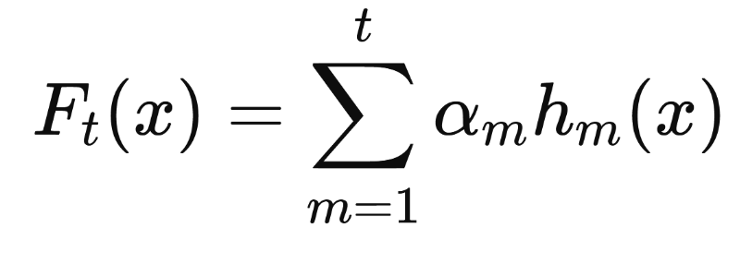
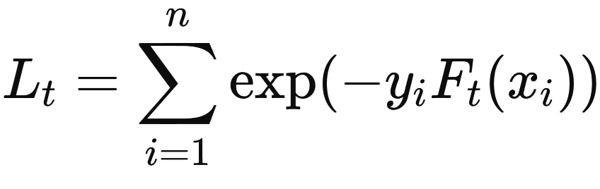
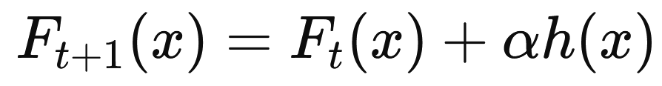
Adaboost
Training exponential loss with Adaboost strictly decreases at every iteration.
Proof:
Ensemble at time t,
Exponential Loss,
Update Rule,

Slide 18
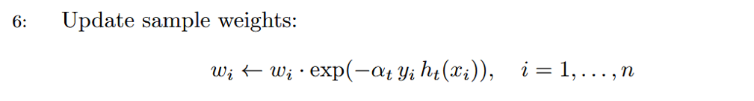
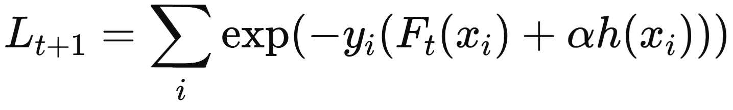
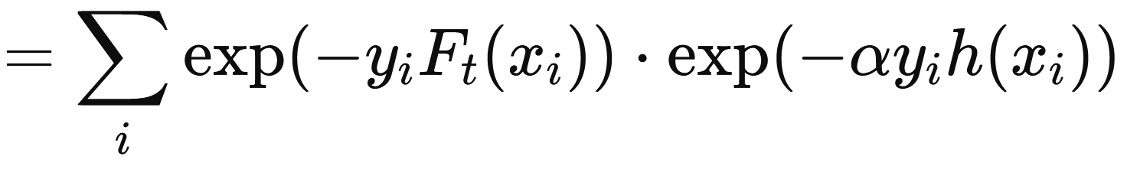
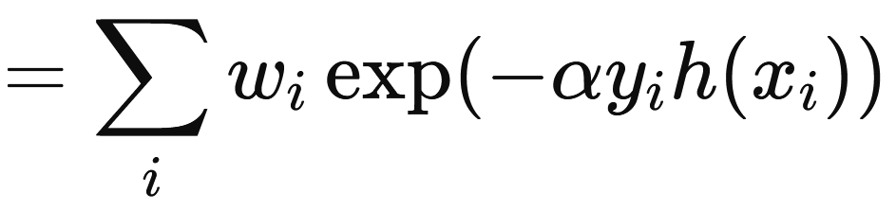
Adaboost
Training exponential loss with Adaboost strictly decreases at every iteration.
Proof:
Loss after step t+1,

Slide 19
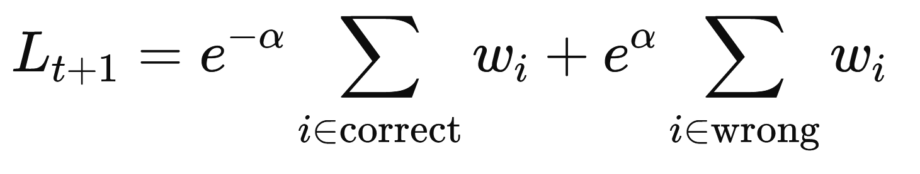
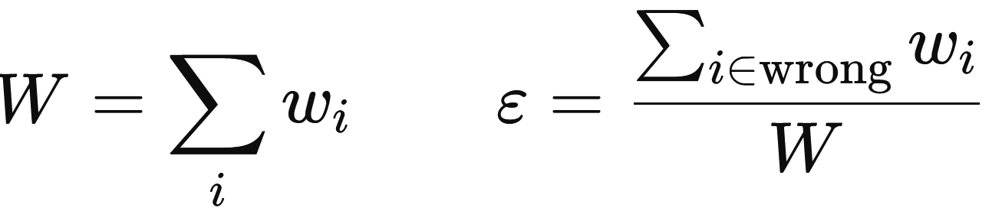
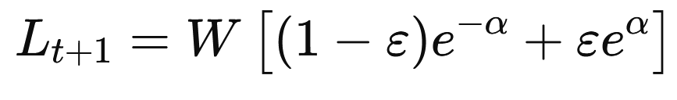
Adaboost
Training exponential loss with Adaboost strictly decreases at every iteration.
Proof:
Split loss into two parts,
Let,

Slide 20
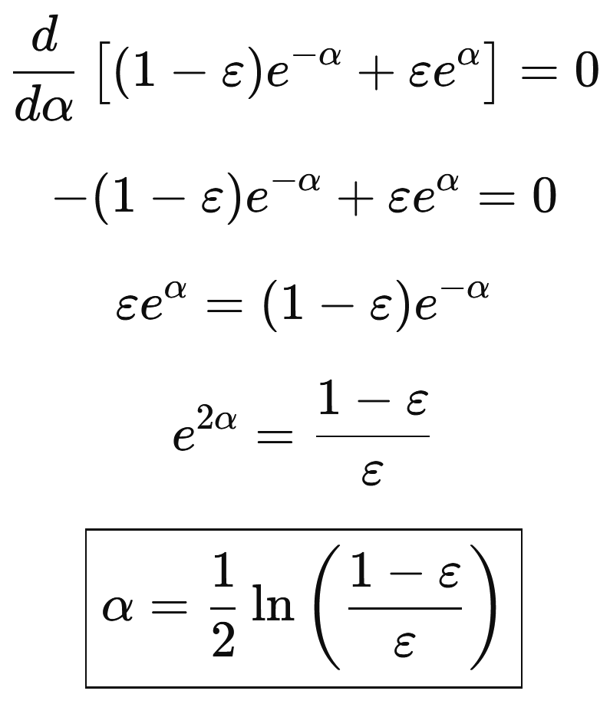
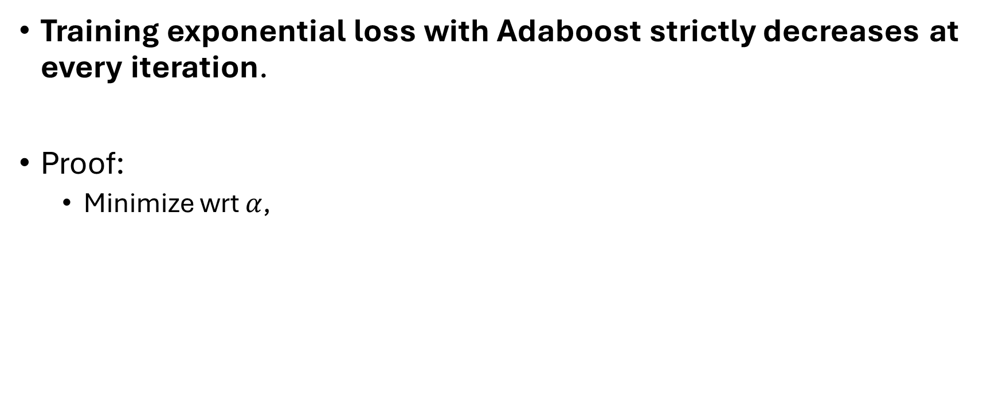
Adaboost
Training exponential loss with Adaboost strictly decreases at every iteration.
Proof:
Minimize wrt $α$,

Slide 21
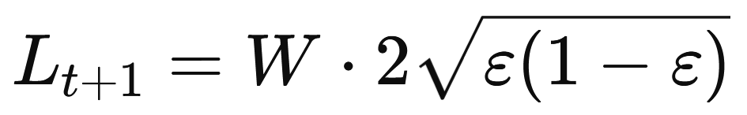
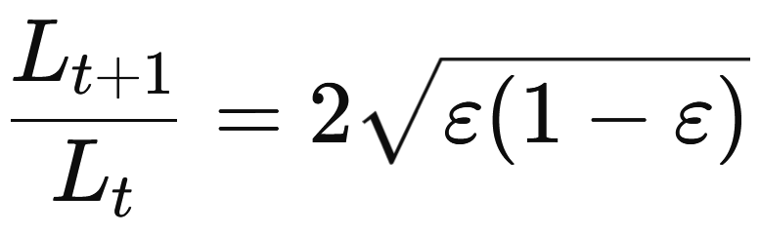
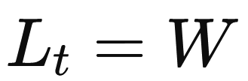
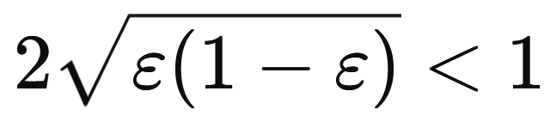
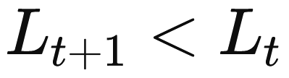
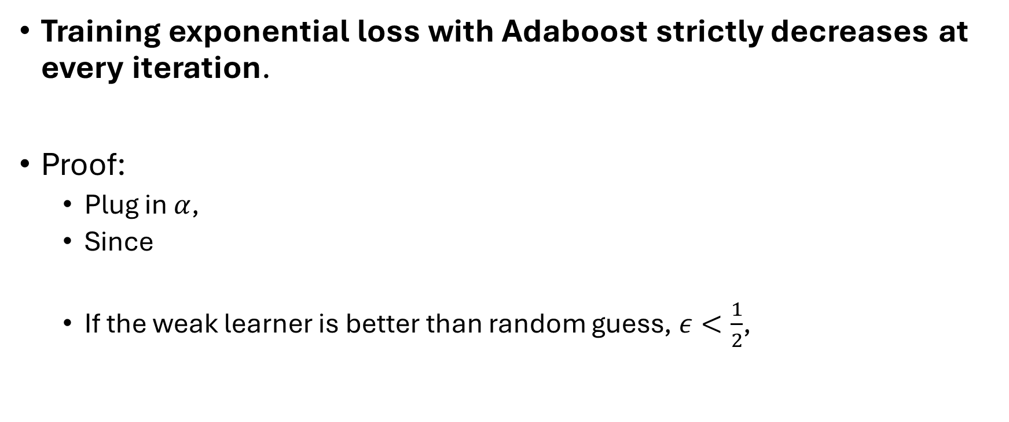
Adaboost
Training exponential loss with Adaboost strictly decreases at every iteration.
Proof:
Plug in $α$,
Since
If the weak learner is better than random guess, $ε<\frac{1}{2}$,

Slide 22
Adaboost
Adaboost reduces bias
But slightly increases variance

Slide 23
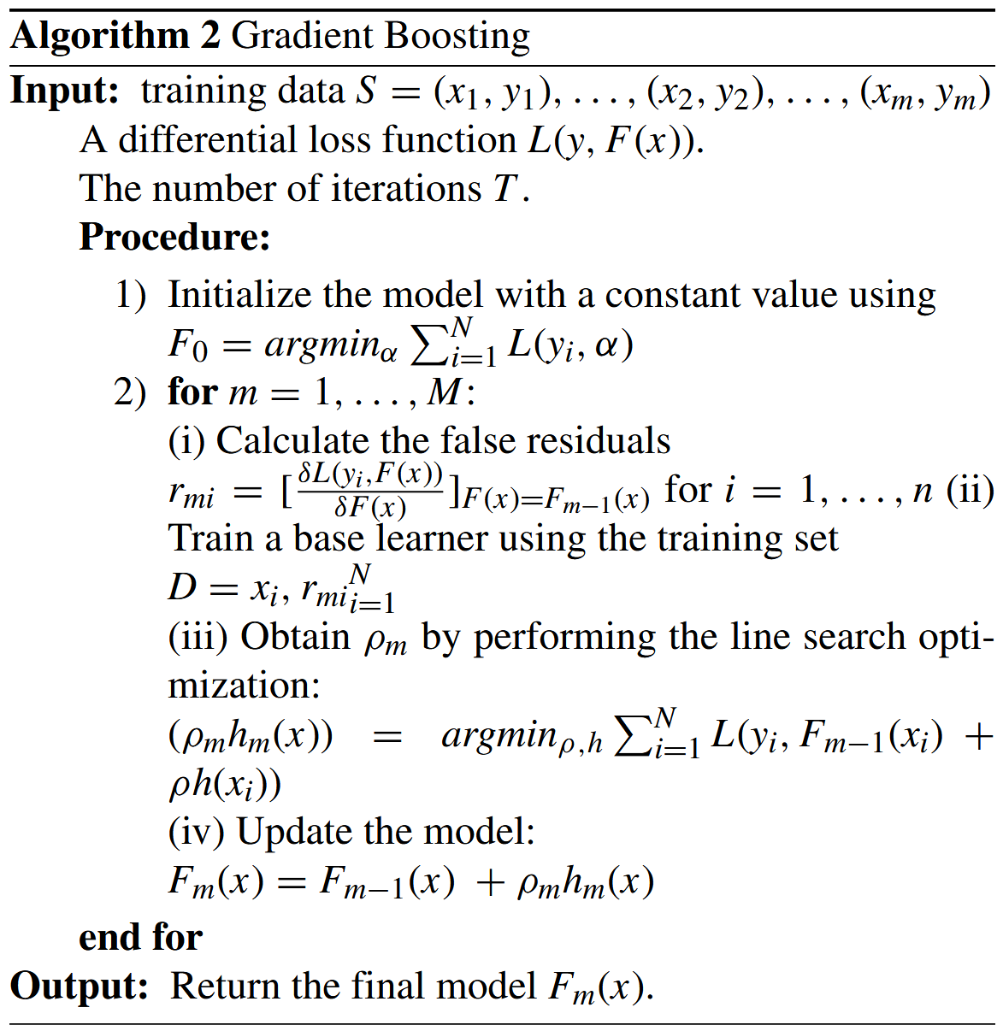
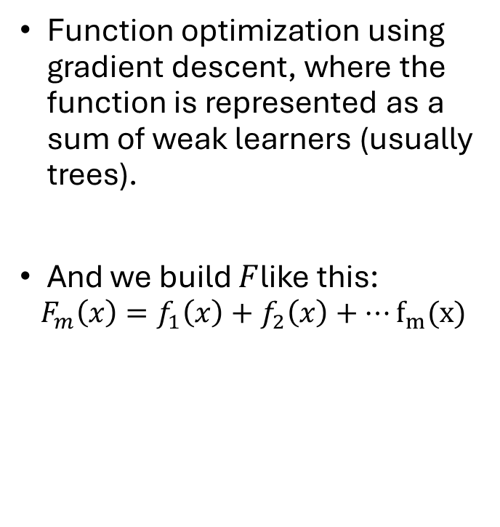
Gradient Boost
Function optimization using gradient descent, where the function is represented as a sum of weak learners (usually trees).
And we build $F$like this:
$$F_{m}\left(x\right)=f_{1}\left(x\right)+f_{2}\left(x\right)+…f_{m}(x)$$

Slide 24
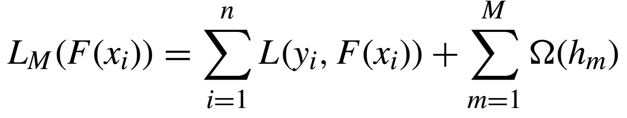
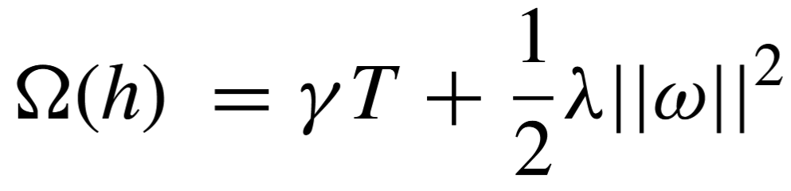
XGBoost
The XGBoost algorithm is a decision tree-based ensemble that employs the gradient boosting framework
But adds a regularization term
The regularization term reduces overfitting

Slide 25
Reference
https://ieeexplore.ieee.org/stamp/stamp.jsp?tp=&arnumber=9893798
https://hastie.su.domains/TALKS/boost.pdf
Optional Reading:
The Elements of Statistical Learning, Chapter 9, 10, 15

